Slide 1
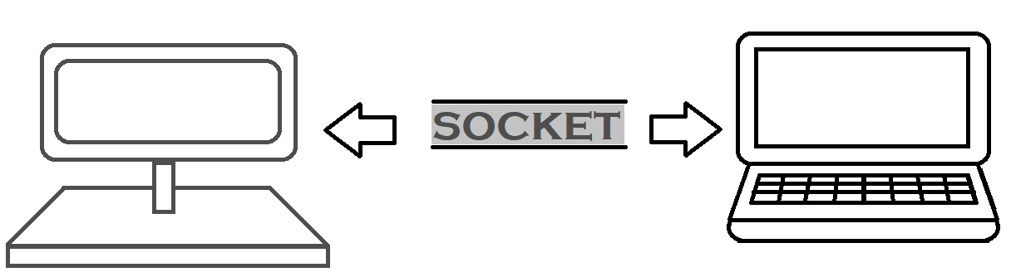
Advance Networking
SUBJECT:
Advanced Java Programming
TOPIC:
Advance Networking
This work is licensed under a Creative Commons Attribution-NonCommercial-ShareAlike 4.0 International License. You are free to use, distribute and modify it, for noncommercial purposes only, provided you acknowledge the source.

Slide 2
Agenda
Networking Basics
TCP, UDP, Ports, DNS, Client-Server Model
TCP/IP in Java
Sockets
URL
The java classes: URL, URLConnection
Datagrams

Slide 3
JAVA NETWORKING
Java Networking is a concept of connecting two or more computing devices together so that we can share resources.
Java socket programming provides facility to share data between different computing devices.
Advantage of Java Networking : Sharing resources

Slide 4
Java Networking Terminology
The widely used java networking terminologies are given below:
IP Address : IP address is a unique number assigned to a node of a network e.g. 192.168.0.1 . It is composed of octets that range from 0 to 255. It is a logical address that can be changed.
Protocol : A protocol is a set of rules basically that is followed for communication. For example:
TCP
FTP
Telnet
SMTP
POP etc.

Slide 5
Java Networking Terminology
Port Number : The port number is used to uniquely identify different applications. It acts as a communication endpoint between applications. The port number is associated with the IP address for communication between two applications.
MAC Address : MAC (Media Access Control) Address is a unique identifier of NIC (Network Interface Controller). A network node can have multiple NIC but each with unique MAC.
Connection-oriented And Connection-less Protocol : In connection-oriented protocol, acknowledgement is sent by the receiver. So it is reliable but slow. The example of connection-oriented protocol is TCP. But, in connection-less protocol, acknowledgement is not sent by the receiver. So it is not reliable but fast. The example of connection-less protocol is UDP.
Socket : A socket is an endpoint between two way communication

Slide 6
The Network is Computer
PC client
Internet Server
Local Area Network
PDA

Slide 7
Increased demand for Internet applications
To take advantage of opportunities presented by the Internet, businesses are continuously seeking new and innovative ways and means for offering their services via the Internet.
This created a huge demand for software designers with skills to create new Internet-enabled applications or migrate existing/legacy applications on the Internet platform.
Object-oriented Java technologies—Sockets, threads, RMI, clustering, Web services-- have emerged as leading solutions for creating portable, efficient, and maintainable large and complex Internet applications.

Slide 8
Elements of C-S Computing
a client, a server, and network
Request
Client
Server
Network
Result
Client machine
Server machine

Slide 9
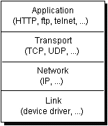
Networking Basics
Computers running on the Internet communicate with each other using either the Transmission Control Protocol (TCP) or the User Datagram Protocol (UDP)

Slide 10
Java Socket Programming
Java Socket programming is used for communication between the applications running on different JRE.
Java Socket programming can be connection-oriented or connection-less.
Socket and ServerSocket classes are used for connection-oriented socket programming and DatagramSocket and DatagramPacket classes are used for connection-less socket programming.
The client in socket programming
must know two information:
IP Address of Server, and
Port number

Slide 11
DNS - Domain name system
The Domain Name system (DNS) associates various sorts of information with so-called domain names.
Most importantly, it serves as the "phone book" for the Internet by translating human-readable computer hostnames, e.g. www.example.com, into the IP addresses, e.g. 208.77.188.166, that networking equipment needs to deliver information.
It also stores other information such as the list of mail exchange servers that accept email for a given domain.

Slide 12
Understanding Ports
TCP
Server
Port
Port
Client
The TCP and UDP protocols use ports to map incoming data to a particular process running on a computer.
app
app
app
app
port
port
port
port
TCP or UDP
Packet
Data
port#
data

Slide 13
Understanding Ports
Port is represented by a positive (16-bit) integer value
Some ports have been reserved to support common/well known services:
ftp 21/tcp
telnet 23/tcp
smtp 25/tcp
login 513/tcp
User level process/services generally use port number value >= 1024

Slide 14
Sockets
Sockets provide an interface for programming networks at the transport layer.
Network communication using Sockets is very much similar to performing file I/O
In fact, socket handle is treated like file handle.
The streams used in file I/O operation are also applicable to socket-based I/O
Socket-based communication is programming language independent.
That means, a socket program written in Java language can also communicate to a program written in Java or non-Java socket program.

Slide 15
Socket Communication
A server (program) runs on a specific computer and has a socket that is bound to a specific port. The server waits and listens to the socket for a client to make a connection request.
server
Connection request
port
Client

Slide 16
Socket Communication
If everything goes well, the server accepts the connection. Upon acceptance, the server gets a new socket bounds to a different port. It needs a new socket (consequently a different port number) so that it can continue to listen to the original socket for connection requests while serving the connected client.
server
port
port
Client
port
Connection

Slide 17
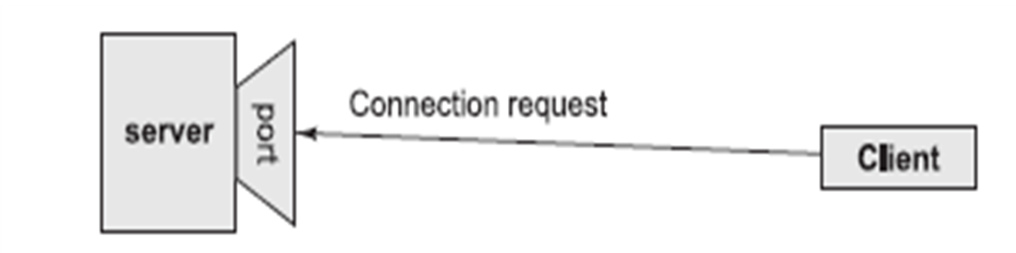
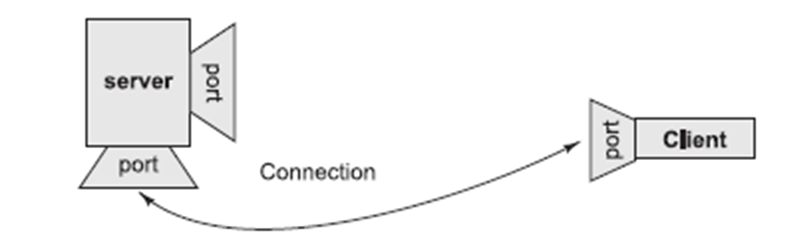
Socket Communication

Slide 18
Cont.
The Classes
ContentHandler, DatagramPacket, DatagramSocket, DatagramSocketImpl, HttpURLConnection, InetAddress, MulticastSocket, ServerSocket, Socket, SocketImpl, URL, URLConnection
The Interfaces
ContentHandlerFactory, FileNameMap, SocketImplFactory , URLStreamHandlerFactory
Exceptions
BindException, ConnectException, MalformedURLException , NoRouteToHostException, ProtocolException, SocketException , UnknownHostException, UnknownServiceException

Slide 19
Transmission Control Protocol
A connection-based protocol that provides a reliable flow of data between two computers.
Provides a point-to-point channel for applications that require reliable communications.
The Hypertext Transfer Protocol (HTTP), File Transfer Protocol (FTP), and Telnet are all examples of applications that require a reliable communication channel
Guarantees that data sent from one end of the connection actually gets to the other end and in the same order it was sent. Otherwise, an error is reported.

Slide 20
User Datagram Protocol
A protocol that sends independent packets of data, called datagrams, from one computer to another with no guarantees about arrival. UDP is not connection-based like TCP and is not reliable:
Sender does not wait for acknowledgements
Arrival order is not guaranteed
Arrival is not guaranteed
Used when speed is essential, even in cost of reliability
e.g. streaming media, games, Internet telephony, etc.

Slide 21
Ports
Data transmitted over the Internet is accompanied by addressing information that identifies the computer and the port for which it is destined.
The computer is identified by its 32-bit IP address, which IP uses to deliver data to the right computer on the network. Ports are identified by a 16-bit number, which TCP and UDP use to deliver the data to the right application.

Slide 22
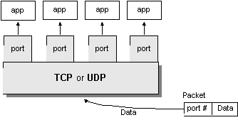
Ports – Cont.
Port numbers range from 0 to 65,535 (16-bit)
Ports 0 - 1023 are called well-known ports. They are reserved for use by well-known services:
20, 21: FTP
23: TELNET
25: SMTP
110: POP3
80: HTTP

Slide 23
Networking Classes in the JDK
Through the classes in java.net, Java programs can use TCP or UDP to communicate over the Internet.
The URL, URLConnection, Socket, and ServerSocket classes all use TCP to communicate over the network.
The DatagramPacket, DatagramSocket, and MulticastSocket classes are for use with UDP.

Slide 24
Networking Classes in the JDK
InetAddress
Socket and ServerSocket Class
URL class

Slide 25
TCP/IP in Java
Accessing TCP/IP from Java is straightforward. The main functionality is in the following classes:
java.net.InetAddress : Represents an IP address (either IPv4 or IPv6) and has methods for performing DNS lookup (next slide).
java.net.Socket : Represents a TCP socket.
java.net.ServerSocket : Represents a server socket which is capable of waiting for requests from clients.

Slide 26
InetAddress
The InetAddress class is used to encapsulate both the numerical IP address and the domain name for that address.
We interact with this class by using the name of an IP host, which is more convenient and understandable than its IP address.
The InetAddress class hides the number inside.

Slide 27
Factory Methods
static InetAddress getLocalHost( )
throws UnknownHostException
static InetAddress getByName(String hostName)
throws UnknownHostException
static InetAddress[ ] getAllByName(String hostName)
throws UnknownHostException

Slide 28
Example:
class InetAddressTest1
{
public static void main(String args[])
throws UnknownHostException
{
InetAddress Address = InetAddress.getLocalHost();
System.out.println(Address);
Address =
InetAddress.getByName("www.google.com");
System.out.println(Address);
InetAddress SW[] =
InetAddress.getAllByName("www.yahoo.com");
for (int i=0; i<SW.length; i++)
System.out.println(SW[i]);
}
}

Slide 29
Instance Methods
class InetAddressTest2
{
public static void main(String args[])
throws UnknownHostException
{
InetAddress Address =
InetAddress.getByName("www.google.com");
System.out.println(Address.getHostAddress());
System.out.println(Address.getHostName());
if(Address.isMulticastAddress())
System.out.println("It is multicast address");
}
}

Slide 30
Sockets and Java Socket Classes
A socket is an endpoint of a two-way communication link between two programs running on the network.
A socket is bound to a port number so that the TCP layer can identify the application that data destined to be sent.
Java’s .net package provides two classes:
Socket – for implementing a client
ServerSocket – for implementing a server

Slide 31
Java Sockets
ServerSocket(1234)
Server
Output/write stream
Client
Input/read stream
Socket(“128.250.25.158”, 1234)
It can be host_name like
“books.google.com” or “localhost”

Slide 32
Client Sockets
Java wraps OS sockets (over TCP) by the objects of class java.net.Socket
Socket(String remoteHost,int remotePort)
Creates a TCP socket and connects it to the remote host on the remote port (hand shake)
Write and read using streams:
InputStream getInputStream()
OutputStream getOutputStream()

Slide 33
Constructors
Socket(String remoteHost, int remotePort)
Socket(InetAddress ip, int remotePort)

Slide 34
Instance Methods
InetAddress getInetAddress( )
int getPort( )
int getLocalPort( )
InputStream getInputStream( )
OutputStream getOutputStream( )
void close( )

Slide 35
Socket class
Method | Description
1) public InputStream getInputStream() | returns the InputStream attached with this socket.
2) public OutputStream getOutputStream() | returns the OutputStream attached with this socket.
3) public synchronized void close() | closes this socket
A socket is simply an endpoint for communications between the machines. The Socket class can be used to create a socket.

Slide 36
ServerSocket class
Method | Description
1) public Socket accept() | returns the socket and establish a connection between server and client.
2) public synchronized void close() | closes the server socket.
The ServerSocket class can be used to create a server socket.
This object is used to establish communication with the clients.

Slide 37
Implementing a Client
1. Create a Socket Object:
client = new Socket( server, port_id );
2. Create I/O streams for communicating with the server.
is = new DataInputStream(client.getInputStream() );
os = new DataOutputStream( client.getOutputStream() );
3. Perform I/O or communication with the server:
Receive data from the server:
String line = is.readLine();
Send data to the server:
os.writeBytes("Hello\n");
4. Close the socket when done:
client.close();

Slide 38
Example: Whois server
class Whois {
public static void main(String args[ ]) throws Exception {
int c;
Socket s = new Socket("internic.net", 43);
InputStream in = s.getInputStream();
OutputStream out = s.getOutputStream();
String str="www.google.com";
byte buf[] = str.getBytes();
out.write(buf);
while ((c = in.read()) != -1)
System.out.print((char) c);
s.close();
}
}

Slide 39
Example: Time server
public class DayTime{
public static void main(String[] args) throws Exception {
Socket theSocket = new Socket("time.nist.gov", 13);
InputStream timeStream =theSocket.getInputStream();
StringBuffer time = new StringBuffer( );
int c;
while ((c = timeStream.read( )) != -1) time.append((char) c);
String timeString = time.toString( ).trim( );
System.out.println("It is " + timeString + " at " + "localhost");
}
}

Slide 40
ServerSocket
This class implements server sockets. A server socket waits for requests to come in over the network. It performs some operation based on that request, and then possibly returns a result to the requester.
A server socket is technically not a socket: when a client connects to a server socket, a TCP connection is made, and a (normal) socket is created for each end point.

Slide 41
Constructors
ServerSocket (int port)
throws BindException, IOException
ServerSocket (int port, int maxQueue)
throws BindException, IOException
ServerSocket (int port, int maxQ, InetAddress ip) throws IOException

Slide 42
Implementing a Server
Open the Server Socket:
ServerSocket server;
DataOutputStream os;
DataInputStream is;
server = new ServerSocket( PORT );
Wait for the Client Request:
Socket client = server.accept();
Create I/O streams for communicating to the client
is = new DataInputStream(client.getInputStream() );
os = new DataOutputStream(client.getOutputStream());
Perform communication with client
Receive from client: String line = is.readLine();
Send to client: os.writeBytes("Hello\n");
Close sockets: client.close();

Slide 43
Accepting Connections
Usually, the accept() method is executed within an infinite loop
i.e., while(true){...}
The accept method returns a new socket (with a new port) for the new channel. It blocks until connection is made.
Syntax:
Socket accept() throws IOException

Slide 44
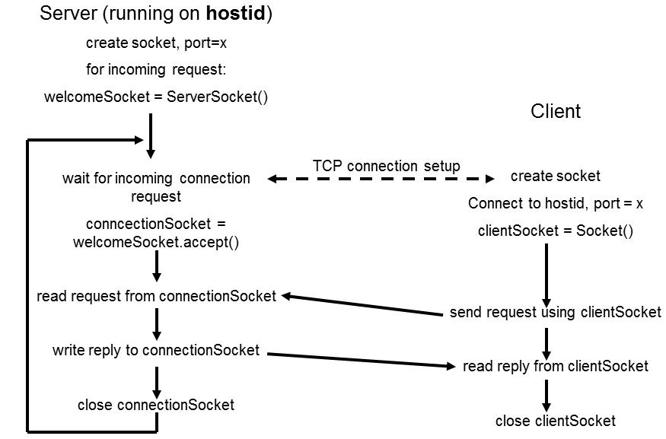
Client-Server Interaction via TCP

Slide 45
Examples
Server1
Client1

Slide 46
Program 1: Sending data from a client to a server (Using Connection Oriented Programming)
import java.io.*;
import java.net.*;
public class Client1 {
public static void main(String[] args)
{
try{
Socket s=new Socket("localhost",6666);
DataOutputStream dout =
new DataOutputStream(s.getOutputStream());
dout.writeUTF("Hello Server");
dout.flush();
dout.close();
s.close();
}
catch(Exception e){System.out.println(e);}
}
}
import java.io.*;
import java.net.*;
public class Server1 {
public static void main(String[] args){
try{
ServerSocket ss=new ServerSocket(6666);
Socket s=ss.accept();
DataInputStream din =
new DataInputStream(s.getInputStream());
String str=(String)din.readUTF();
System.out.println("Client: "+str);
din.close();
s.close();
ss.close();
}
catch(Exception e)
{System.out.println(e);}
}
}

Slide 47
Program 1: Sending data from client to server
Server1.java
import java.io.*;
import java.net.*;
public class Server1 {
public static void main(String[] args){
try{
ServerSocket ss=new ServerSocket(6666);
Socket s=ss.accept();
DataInputStream dis =
new DataInputStream(s.getInputStream());
String str=(String)dis.readUTF();
System.out.println("Client says= "+str);
ss.close();
}
catch(Exception e)
{System.out.println(e);}
}
}

Slide 48
Program 1: Sending data from client to server
Client1.java
import java.io.*;
import java.net.*;
public class Client1 {
public static void main(String[] args)
{
try{
Socket s=new Socket("localhost",6666);
DataOutputStream dout =
new DataOutputStream(s.getOutputStream());
dout.writeUTF("Hello Server");
dout.flush();
dout.close();
s.close();
}
catch(Exception e){System.out.println(e);}
}
}

Slide 49
URL - Uniform Resource Locator
URL is a reference (an address) to a resource on the Internet.
A resource can be a file, a database query and more.
URLs are just a subset of the more general concept of Uniform Resource Identifiers (URIs) which are meant to describe all points in the information space
http://www.java.com:80/javaintro/index.html#Network
http
www.java.com:
80 javaintro/index.html
javaintro/index.html
#Network
Protocol
Host Name
Port Number
Path & File Name
Reference

Slide 50
Class URL
Class URL represents a Uniform Resource Locator, a pointer to a "resource" on the World Wide Web.
We distinguish between:
Absolute URL - contains all of the information necessary to reach the resource.
Relative URL - contains only enough information to reach the resource relative to (or in the context of) another URL.

Slide 51
Constructors
URL(String urlSpecifier)
URL(URL urlObj, String urlSpecifier)
URL(String protName, String hostName, int port, String path)
URL(String protName, String hostName, String path)

Slide 52
Commonly used methods of Java URL class
Method | Description
public String getProtocol() | Returns the protocol of the URL.
public String getHost() | Returns the host name of the URL.
public String getPort() | Returns returns the Port Number of the URL.
public String getFile() | Returns the file name of the URL.
public URLConnection openConnection() | Returns the instance of URLConnection i.e. associated with this URL.
public String getQuery() | Returns the query string of the URL.
public String toString() | Returns the string representation of the URL.
public String getDefaultPort() | it returns the default port of the URL.

Slide 53
Example of Java URL class
import java.io.*;
import java.net.*;
public class URLDemo{
public static void main(String[ ] args){
try{
URL url=new URL("http://srpec.org.in/contacts");
System.out.println("Protocol: "+url.getProtocol());
System.out.println("Host Name: "+url.getHost());
System.out.println("Port Number: "+url.getPort());
System.out.println("File Name: "+url.getFile());
}
catch(Exception e){System.out.println(e);}
}
}

Slide 54
Example
class URLDemo{
public static void main(String args[]) throws MalformedURLException
{
URL hp = new URL("http://content-ind.cricinfo.com/ci/content/current/story/news.html");
System.out.println("Protocol: " + hp.getProtocol());
System.out.println("Port: " + hp.getPort());
System.out.println("Host: " + hp.getHost());
System.out.println("File: " + hp.getFile());
System.out.println("Ext:" + hp.toExternalForm());
}
}

Slide 55
Output
Protocol: http
Port: -1
Host: content-ind.cricinfo.com
File: /ci/content/current/story/news.html
Ext:http://content-ind.cricinfo.com/ci/content/current/story/news.html

Slide 56
URLConnection class
The Java URLConnection class represents a communication link between the URL and the application.
This class can be used to read and write data to the specified resource referred by the URL.
The openConnection() method of URL class returns the object of URLConnection class.

Slide 57
URLConnection class
URLConnection is an abstract class that represents an active connection to a resource specified by a URL.
The URLConnection class has two different but related purposes.
First, it provides more control over the interaction with a server (especially an HTTP server) than the URL class.
We can inspect the header sent by the server and respond accordingly. We can set the header fields used in the client request. We can use a URLConnection to download binary files.
URLConnection lets us send data back to a web server with POST or PUT and use other HTTP request methods.

Slide 58
Process
Construct a URL object.
Invoke the URL object's openConnection( ) method to retrieve a URLConnection object for that URL.
Configure the URLConnection.
Read the header fields.
Get an input stream and read data.
Get an output stream and write data.
Close the connection.

Slide 59
Reading Data from Server
Construct a URL object.
Invoke the URL object's openConnection( ) method to retrieve a URLConnection object for that URL.
Invoke the URLConnection's getInputStream( ) method.
Read from the input stream using the usual stream API.
The getInputStream() method returns a generic InputStream that lets you read and parse the data that the server sends.
public InputStream getInputStream( )

Slide 60
URLConnection Example
import java.net.*;
import java.io.*;
public class URLConnectionReader {
public static void main(String[] args) throws Exception {
URL yahoo = new URL("http://www.yahoo.com/");
URLConnection yc = yahoo.openConnection();
BufferedReader in = new BufferedReader(
new InputStreamReader(
yc.getInputStream()));
String inputLine;
while ((inputLine = in.readLine()) != null)
System.out.println(inputLine);
in.close();
}
}

Slide 61
URLConnection Example2
public class SourceViewer2 {
public static void main (String[] args) {
if (args.length > 0) {
try {
//Open the URLConnection for reading
URL u = new URL(args[0]);
URLConnection uc = u.openConnection( );
InputStream raw = uc.getInputStream( );
InputStream buffer = new BufferedInputStream(raw);
// chain the InputStream to a Reader
Reader r = new InputStreamReader(buffer);
int c;
while ((c = r.read( )) != -1)
{ System.out.print((char) c); }
}
catch (MalformedURLException ex) {
System.err.println(args[0]+" is not a parseable URL");
}
catch (IOException ex) {
System.err.println(ex);
}
} // end if
} // end main
} // end SourceViewer2

Slide 62
Difference between URL and URLConnection
URLConnection provides access to the HTTP header.
URLConnection can configure the request parameters sent to the server.
URLConnection can write data to the server as well as read data from the server.

Slide 63
Header Information
HTTP/1.1 200 OK
Date: Mon, 18 Oct 1999 20:06:48 GMT
Server: Apache/1.3.4 (Unix) PHP/3.0.6 mod_perl/1.17
Last-Modified: Mon, 18 Oct 1999 12:58:21 GMT
Accept-Ranges: bytes
Content-Length: 35259
Connection: close
Content-Type: text/html

Slide 64
Methods
public String getContentType( )
public int getContentLength( )
public long getDate( )
public long getExpiration( )
public long getLastModified( )

Slide 65
Example
catch (MalformedURLException ex) {
System.out.println("I can't understand this URL...");
}
catch (IOException ex) {
System.err.println(ex);
}
System.out.println( );
} // end main
} // end HeaderViewer
public class HeaderViewer {
public static void main(String args[]) { try {
URL u = new URL("http://www.rediffmail.com/index.html");
URLConnection uc = u.openConnection( );
System.out.println("Content-type: " +
uc.getContentType( ));
System.out.println("Content-encoding: "
+ uc.getContentEncoding( ));
System.out.println("Date: " + new Date(uc.getDate( )));
System.out.println("Last modified: "
+ new Date(uc.getLastModified( )));
System.out.println("Expiration date: "
+ new Date(uc.getExpiration( )));
System.out.println("Content-length: " +
uc.getContentLength( ));
} // end try

Slide 66
Sample Output
Sample output:
Content-type: text/htmlContent-encoding: nullDate: Mon Oct 18 13:54:52 PDT 1999Last modified: Sat Oct 16 07:54:02 PDT 1999Expiration date: Wed Dec 31 16:00:00 PST 1969 Content-length: -1
Sample output for: http://www.oreilly.com/graphics/space.gif
Content-type: image/gifContent-encoding: nullDate: Mon Oct 18 14:00:07 PDT 1999Last modified: Thu Jan 09 12:05:11 PST 1997Expiration date: Wed Dec 31 16:00:00 PST 1969 Content-length: 57

Slide 67
Retrieving Header field
public String getHeaderField(String name)
Example:
String contentType = uc.getHeaderField("content-type");
String contentEncoding = uc.getHeaderField("content-encoding"));
String data = uc.getHeaderField("date");
String expires = uc.getHeaderField("expires");
String contentLength = uc.getHeaderField("Content-length");

Slide 68
Java HttpURLConnection class
The Java HttpURLConnection class is http specific URLConnection. It works for HTTP protocol only.
By the help of HttpURLConnection class, you can information of any HTTP URL such as header information, status code, response code etc.
The java.net.HttpURLConnection is subclass of URLConnection class.

Slide 69
How to get the object of HttpURLConnection class
The openConnection() method of URL class returns the object of URLConnection class. Syntax:
public URLConnection openConnection()throws IOException{}
You can typecast it to HttpURLConnection type as given below.
URL url=new URL("http://www.javatpoint.com/java-tutorial");
HttpURLConnection huc=(HttpURLConnection)url.openConnection();

Slide 70
Datagrams
UDP / Connection-less Programming

Slide 71
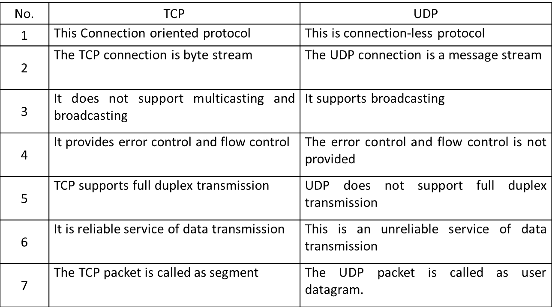
TCP vs. UDP

Slide 72
UDP in Java
DatagramPacket
DatagramSocket

Slide 73
Datagrams
A datagram is an independent, self-contained message sent over the network whose arrival, arrival time, and content are not guaranteed.
The java.net package contains three classes to help you write Java programs that use datagrams to send and receive packets over the network: DatagramSocket and DatagramPacket

Slide 74
Receiving DatagramPacket
DatagramPacket Constructor
public DatagramPacket(byte[] buffer, int length)
public DatagramPacket(byte[] buffer, int offset, int length)
Example:
byte[] buffer = new byte[8192];
DatagramPacket dp = new
DatagramPacket(buffer, buffer.length);

Slide 75
Sending Datagrams
DatagramPacket Constructor
public DatagramPacket
(
byte[] barr, int length,
InetAddress address, int port
)
Creates a datagram packet. This constructor is used to send the packets.

Slide 76
DatagramSocket
DatagramSocket Constructors
public DatagramSocket( ) throws SocketException
public DatagramSocket(int port) throws SocketException
public DatagramSocket(int port, InetAddress interface) throws SocketException

Slide 77
Sending and Receiving Packets
DatagramSocket Methods
public void send(DatagramPacket dp) throws IOException
public void receive(DatagramPacket dp) throws IOException

Slide 78
Program 1: Sending data from a Sender to Receiver (Using Connection-Less Programming)
import java.io.*;
import java.net.*;
public class DatagramSender
{
public static void main(String[] args)
throws Exception
{
DatagramSocket ds = new DatagramSocket();
String str = "Hello Datagrams";
InetAddress ip =
InetAddress.getByName("127.0.0.1");
DatagramPacket dp =
new DatagramPacket(str.getBytes(), str.length(), ip, 3000);
ds.send(dp);
ds.close();
}
}
import java.io.*;
import java.net.*;
public class DatagramReceiver
{
public static void main(String[] args)
throws Exception
{
DatagramSocket ds = new DatagramSocket(3000);
byte[] buf = new byte[1024];
DatagramPacket dp =
new DatagramPacket(buf, 1024);
ds.receive(dp);
String str =
new String(dp.getData(), 0, dp.getLength());
System.out.println(str);
ds.close();
}
}

Slide 79
DatagramSocket Class
Methods

Slide 80
Method | Description
void bind(SocketAddress addr) | Binds the DatagramSocket to a specific address and port.
void connect(InetAddress address, int port) | Connects the socket to a remote address for the socket.
void send(DatagramPacket p) | Sends the datagram packet from the socket.
void receive(DatagramPacket p) | Receives the datagram packet from the socket.
void disconnect() | Disconnects the socket.
void close() | Closes the datagram socket.
DatagramChannel getChannel() | Returns a unique DatagramChannel object associated with the datagram socket.
InetAddress getInetAddress() | Returns the address to where the socket is connected.
InetAddress getLocalAddress() | Gets the local address to which the socket is connected.
int getLocalPort() | Returns the port number on the local host to which the socket is bound.
int getPort() | Returns the port number to which the socket is connected.
boolean isClosed() | Returns the status of socket i.e. closed or not.
boolean isConnected() | Returns the connection state of the socket.

Slide 81
DatagramPacket Class
Methods

Slide 82
Method | Description
InetAddress getAddress() | It returns the IP address of the machine to which the datagram is being sent or from which the datagram was received.
byte[] getData() | It returns the data buffer.
int getLength() | It returns the length of the data to be sent or the length of the data received.
int getOffset() | It returns the offset of the data to be sent or the offset of the data received.
int getPort() | It returns the port number on the remote host to which the datagram is being sent or from which the datagram was received.
SocketAddress getSocketAddress() | It gets the SocketAddress (IP address + port number) of the remote host that the packet is being sent to or is coming from.
void setAddress (InetAddress iaddr) | It sets the IP address of the machine to which the datagram is being sent.
void setData(byte[] buff) | It sets the data buffer for the packet.
void setLength(int length) | It sets the length of the packet.
void setPort(int iport) | It sets the port number on the remote host to which the datagram is being sent.
void setSocketAddress (SocketAddress addr) | It sets the SocketAddress (IP address + port number) of the remote host to which the datagram is being sent.

Slide 83
Cont.
The format of datagram packet is:
| Msg | length | Host | serverPort |
Java supports datagram communication through the following classes:
DatagramPacket
DatagramSocket
The class DatagramPacket contains several constructors that can be used for creating packet object.
One of them is:
DatagramPacket(byte[] buf, int length, InetAddress address, int port);
This constructor is used for creating a datagram packet for sending packets of length length to the specified port number on the specified host.

Slide 84
Cont.
The message to be transmitted is indicated in the first argument.
The key methods of DatagramPacket class are:
byte[] getData()
Returns the data size.
int getLength()
Returns the length of the data to be sent or the length of the data received.

Slide 85
Cont.
void setData(byte[] buf)
Sets the data buffer size for this packet.
void setLength(int length)
Sets the length for this packet.

Slide 86
Cont.
The class DatagramSocket supports various methods that can be used for transmitting or receiving data a datagram over the network. The two key methods are:
void send(DatagramPacket p)
Sends a datagram packet from this socket.
void receive(DatagramPacket p)
Receives a datagram packet from this socket.

Slide 87
Example:
UDPServer
UDPClient

Slide 88
Server Program
import java.io.*;
import java.net.*;
public class udp_server
{
public static void main(String args[])
{
DatagramSocket sock = null;
try
{
//1. creating a server socket, parameter is local port number
sock = new DatagramSocket(7777);

Slide 89
Cont.
//buffer to receive incoming data
byte[] buffer = new byte[65536];
DatagramPacket incoming = new DatagramPacket(buffer, buffer.length);
//2. Wait for an incoming data
packet("Server socket created. Waiting for incoming data...");
//communication loop
while(true)
{
sock.receive(incoming);
byte[] data = incoming.getData();
String s = new String(data, 0, incoming.getLength());

Slide 90
Cont.
//echo the details of incoming data - client ip : client port - client message
packet(incoming.getAddress().getHostAddress() + " : " + incoming.getPort() + " - " + s);
s = "OK : " + s;
DatagramPacket dp = new DatagramPacket(s.getBytes() , s.getBytes().length , incoming.getAddress() , incoming.getPort());
sock.send(dp); } }
catch(IOException e)
{ System.err.println("IOException " + e); }
} }

Slide 91
Client Program
import java.io.*;
import java.net.*;
public class udp_client
{
public static void main(String args[])
{
DatagramSocket sock = null;
int port = 7777;
String s;
BufferedReader cin = new BufferedReader(new InputStreamReader(System.in));

Slide 92
Cont.
try
{
sock = new DatagramSocket();
InetAddress host = InetAddress.getByName("localhost");
while(true)
{
//take input and send the packet
packet ("Enter message to send : ");
s = (String)cin.readLine();
byte[] b = s.getBytes();

Slide 93
Cont.
DatagramPacket dp = new DatagramPacket(b , b.length , host , port);
sock.send(dp);
//now receive reply
//buffer to receive incoming data
byte[] buffer = new byte[65536];
DatagramPacket reply = new DatagramPacket(buffer, buffer.length);
sock.receive(reply);

Slide 94
Cont.
byte[] data = reply.getData();
s = new String(data, 0, reply.getLength());
//echo the details of incoming data - client ip : client port - client message
packet(reply.getAddress().getHostAddress() + " : " + reply.getPort() + " - " + s); } }
catch(IOException e)
{
System.err.println("IOException " + e); }
}
}

Slide 95
Remote Method Invocation
(RMI)

Slide 96
Till now
We worked with only local objects
Local host
Object 1
Object 2

Slide 97
Now…
We will work with remote objects
Network and Distributed Objects
Local host
Remote host
Object 1
Object 3
Object 2

Slide 98
The general idea of RMI
Instantiate an object on another machine
Invoke methods on the remote object
Method call
Object1
Object2
Result returned
Computer 1
Computer 2

Slide 99
The general idea of RMI with Stub & Skeleton
Same idea represented by many in following way:
computer 1
computer 2
Object1
Object2
Method call
Result returned
Stub
Skeleton

Slide 100
General idea of RMI w.r.t. Java Code
Java RMI allowed programmer to execute remote function class using the same semantics as local functions calls.
Local Machine (Client)
SampleServer remoteObject;
int s;
…
s = remoteObject.sum(1,2);
System.out.println(s);
Remote Machine (Server)
public int sum(int a,int b) {
return a + b;
}
1,2
3

Slide 101
RMI Architecture
Client
Server
Stubs
Skeletons
Remote
Reference
Remote
Reference
Network (Transport Layer)

Slide 102
How RMI works?
Java makes RMI (Remote Method Invocation) fairly easy
RMI is purely Java-specific
Java to Java communications only
To send a message to a remote “server object,”
The “client object” has to find the object
Do this by looking it up in a registry
The client object then has to marshal the parameters (prepare them for transmission)
Java requires Serializable parameters
The server object has to unmarshal its parameters, do its computation, and marshal its response
The client object has to unmarshal the response

Slide 103
RMI Terminology
Remote object ➔ An object on another computer
Client object ➔ Object making the request (sending a message to the other object by a method call)
Server object ➔ Object receiving the request
As usual, “client” and “server” can easily trade roles (each can make requests of the other)
The rmiregistry is a special server that looks up objects by name (which are unique)
Hopefully, the name is unique!
rmic is a special compiler for creating stub (client) and skeleton (server) classes

Slide 104
RMI Terminology (cont.)
Client - user interface
Server - data source
Stubs
marshals argument data (serialization)
unmarshals results data (deserialization)
Skeletons (not reqd w/Java 2)
unmarshals argument data
marshals results data

Slide 105
RMI Processes
For RMI, you need to be running three processes
The Client
The Server
The Object Registry, rmiregistry, which is like a DNS service for objects

Slide 106
Overall mechanism
The server must first bind its name to the registry
The client lookup the server name in the registry to establish remote references.
The Stub serializing the parameters to skeleton, the skeleton invoking the remote method and serializing the result back to the stub.
Registry
lookup
bind
Client
Server
Call
Stub
Skeleton
Return
Local Computer
Remote Computer

Slide 107
Overall mechanism (cont.)
A client invokes a remote method, the call is first forwarded to skeleton.
The stub is responsible for sending the remote call over to the server-side skeleton
The stub opening a socket to the remote server, marshaling the object parameters and forwarding the data stream to the skeleton.
A skeleton contains a method that receives the remote calls, unmarshals the parameters, and invokes the actual remote object implementation.

Slide 108
The Steps
Define the remote Interface to the server
Create the Server (the remote object) by implementing the remote interface.
Create the Client
Compile the source files (javac) →
Interface, Server, Client
Generate client Stubs and server Skeletons (rmic)
Start the RMI registry
Start the remote server objects
Run the client

Slide 109
Interfaces
Interfaces define behavior
Classes define implementation
So,
In order to use a remote object, the client must know its behavior (interface), but does not need to know its implementation (class)
In order to provide an object, the server must know both its interface (behavior) and its class (implementation)
In short,
The interface must be available to both client and server
The class of any transmitted object must be on both client and server
The class whose method is being used should only be on the server

Slide 110
Classes
A Remote class is one whose instances can be accessed remotely
On the computer where it is defined, instances of this class can be accessed just like any other object
On other computers, the remote object can be accessed via object handles
A Serializable class is one whose instances can be marshaled (turned into a linear sequence of bits)
Serializable objects can be transmitted from one computer to another
It probably isn’t a good idea for an object to be both remote and serializable

Slide 111
Conditions to serialize an Object
If an object is to be serialized:
The class must be declared as public
The class must implement Serializable
However, Serializable does not declare any methods
The class must have a no-argument constructor
All fields of the class must be serializable: either primitive types or Serializable objects
Exception: Fields marked transient will be ignored during serialization

Slide 112
Remote interfaces and classes
A Remote class has two parts:
The interface (used by both client and server):
Must be public
Must extend the interface java.rmi.Remote
Every method in the interface must declare that it throws java.rmi.RemoteException (other exceptions may also be thrown)
The class itself (used only by the server):
Must implement the Remote interface
Should extend java.rmi.server.UnicastRemoteObject
May have locally accessible methods that are not in its Remote interface

Slide 113
Remote & Serializable
A Remote object lives on another computer (such as the Server)
You can send messages to a Remote object and get responses back from the object
All you need to know about the Remote object is its interface
Remote objects don’t pose much of a security issue
You can transmit a copy of a Serializable object between computers
The receiving object needs to know how the object is implemented; it needs the class as well as the interface
There is a way to transmit the class definition
Accepting classes does pose a security issue

Slide 114
Server
The class that defines the server object should extend UnicastRemoteObject
This makes a connection with exactly one other computer
If you must extend some other class, you can use exportObject() instead
Sun does not provide a MulticastRemoteObject class
The server class needs to register its server object:
String url = "rmi://" + host + ":" + port + "/" + objectName;
The default port is 1099
Naming.rebind(url, object);
Every remotely available method must throw a RemoteException (because connections can fail)
Every remotely available method should be synchronized

Slide 115
RMI Example
Hello, World!

Slide 116
Hello world server: interface
import java.rmi.*;
public interface HelloInterface extends Remote
{ public String say() throws RemoteException; }

Slide 117
Hello world server: class
import java.rmi.*; import java.rmi.server.*; public class Hello extends UnicastRemoteObject implements HelloInterface
{ private String message;
// Strings are serializable
public Hello (String msg) throws RemoteException
{ message = msg; }
public String say() throws RemoteException
{ return message; } }

Slide 118
Registering the hello world server
class HelloServer
{ public static void main (String[] argv) { try
{
Naming.rebind("rmi://localhost/HelloServer",
new Hello("Hello, world!")); System.out.println("Hello Server is ready."); } catch (Exception e)
{ System.out.println("Hello Server failed:"+e); } } }

Slide 119
Running the hello world client program
class HelloClient
{ public static void main (String[] args)
{ HelloInterface hello; String name = "rmi://localhost/HelloServer"; try
{ hello = (HelloInterface)Naming.lookup(name); System.out.println(hello.say()); } catch (Exception e) { System.out.println("Exception: "+e); } } }

Slide 120
The Steps
Create the Interface to the server
Create the Server
Create the Client
Compile the Interface (javac)
Compile the Server (javac)
Compile the Client (javac)
Generate Stubs and Skeletons (rmic)

Slide 121
rmic command
The class that implements the remote object should be compiled as usual
Then, it should be compiled with rmic:
rmic Hello
This will generate files Hello_Stub.class and Hello_Skel.class
These classes do the actual communication
The “Stub” class must be copied to the client area
The “Skel” was needed in SDK 1.1 but is no longer necessary

Slide 122
Running RMI
Run following command in three different terminal windows:
Run the registry program:
rmiregistry
Run the server program:
java HelloServer
Run the client program:
java HelloClient
If all goes well, it should o/p as the following message:
“Hello, world!”

Slide 123
RMI Example 2
Remote Server for calculating Sum

Slide 124
Step 1: Defining the Remote Interface
/* SampleServer.java */
import java.rmi.*;
public interface SumServer extends Remote
{
public int sum(int a,int b)
throws RemoteException;
}

Slide 125
Step 2: Develop the remote object and its interface
/* SampleServerImpl.java */
import java.rmi.*;
import java.rmi.server.*;
import java.rmi.registry.*;
public class SampleServerImpl extends UnicastRemoteObject implements SampleServer
{
SampleServerImpl() throws RemoteException
{ super(); }
//Implement the remote methods
public int sum(int a,int b) throws RemoteException
{ return a + b; }
}

Slide 126
Step 2: Develop the remote object and its interface
/* SampleServerImpl.java */
public static void main(String args[]) {
try {
//set the security manager
System.setSecurityManager(new RMISecurityManager());
//create a local instance of the object
SampleServerImpl Server = new SampleServerImpl();
//put the local instance in the registry
Naming.rebind("SAMPLE-SERVER" , Server);
System.out.println("Server waiting.....");
}
catch (java.net.MalformedURLException me) {
System.out.println("Malformed URL: "+ me.toString()); }
catch (RemoteException re) {
System.out.println("Remote exception: “
+ re.toString()); }
}

Slide 127
Step 3: Develop the client program
import java.rmi.*;
import java.rmi.server.*;
import java.net.*;
public class SampleClient
{
public static void main(String[] args)
{
// set the security manager for the client
System.setSecurityManager(new RMISecurityManager());
//get the remote object from the registry
try {
System.out.println("Security Manager loaded");
String url = "//localhost/SAMPLE-SERVER";
SampleServer remoteObject =
(SampleServer)Naming.lookup(url);
System.out.println("Got remote object");
System.out.println("1 + 2 = "+remoteObject.sum(1,2) );
}

Slide 128
Step 3: Develop the client program
catch (RemoteException e)
{
System.out.println("Lookup Error: "+ e.toString());
}
catch (MalformedURLException e)
{
System.out.println("Malformed URL: "+e.toString());
}
catch (NotBoundException e)
{
System.out.println("NotBound: " + e.toString());
}
}
}

Slide 129
Step 4 & 5: Compile the Java source files & Generate the client stubs and server skeletons
C:\rmi> set CLASSPATH="."
C:\rmi> javac SampleServer.java
C:\rmi> javac SampleServerImpl.java
C:\rmi> rmic SampleServerImpl
C:\rmi> javac SampleClient.java

Slide 130
Step 6: Start the RMI registry
C:\rmi> start rmiregistry

Slide 131
Steps 7 & 8: Start the remote server objects & Run the client
C:\rmi> java SampleServerImpl
C:\rmi> java SampleClient

Slide 132
Steps’ summary
Start the registry server, rmiregistry
Start the object server
The object server registers an object, with a name, with the registry server
Start the client
The client looks up the object in the registry server
The client makes a request
The request actually goes to the Stub class
The Stub classes on client and server talk to each other
The client’s Stub class returns the result

